Slide 1


Gabriella S.
7/4/2023

Slide 2

Outline
Executive Summary
Introduction
Methodology
Results
Conclusion
Appendix

Slide 3
Executive Summary
Summary of Methodology:
Data collection with the use of APIs, Web Scrapping, and Data Wrangling.
Explored collected data with the use of SQL and data visualization tools.
Generated interactive visual analytics using Folium tools and predicted data with Machine Learning.
Summary of Results:
Explored and analyzed data with the use of interactive dashboards and visualizations to predict if the Falcon 9 first stage will land successfully.

Slide 4
Introduction
Project background and context
SpaceX is a company that advertises Falcon 9 rocket launches for 100 million dollars less than other providers given that the first stage of SpaceX rocket can be reused. To accomplish this, we will need to predict with the use of machine learning if the first stage will land successfully..
Problems you want to find answers
What factors we will need to take into consideration to determine if the rocket will land successfully.
What conditions we will need to take in place to ensure that the first stage can be reused.

Slide 5

Section 1

Slide 6
Methodology
Executive Summary
Data collection methodology:
Data was collected with two tools: SpaceX API and web scraping.
Performed data wrangling
Categorical features were created utilizing One-hot encoding.
Performed exploratory data analysis (EDA) using visualization and SQL.
Performed interactive visual analytics using Folium and Plotly Dash.
Performed predictive analysis using classification models.

Slide 7
Data Collection
1
3
4
2
SpaceX API.
Json: .json()
Clean and complete any missing information.
Web Scraping using BeautifulSoup.
Pandas Df: .json_normalize().
5
Interactive Dashboards with visual analytics.

Slide 8
Data Collection – SpaceX API
response=requests.get(spacex_url)
response.status_code
data=pd.json_normalize(response.json())
df=pd.DataFrame.from_dict(launch_dict)
data_falcon9=df[df['BoosterVersion']!='Falcon 1']
data_falcon9.loc[:,'FlightNumber']=list(range(1,data_falcon9.shape[0]+1))data_falcon9
To complete the Data Collection, we used the get request to the SpaceX API and we cleaned the requested data.
The link to the Data Collection Lab can be found here: GitHub Link

Slide 9
Data Collection - Scraping
Install BeautifulSoup
df=pd.DataFrame.from_dict(launch_dict)df.head()
response=requests.get(static_url).text
soup=BeautifulSoup(response,'html.parser')
html_tables=soup.find_all("table")
print(html_tables)
We performed Web Scraping to collect Falcon 9 historical launch records from Wikipedia.
The link to the Data Collection Lab can be found here: Git Hub Link

Slide 10
Data Wrangling
Load SpaceX dataset: df=pd.read_csv(dataset_part_1_csv)
Create the outcome Labels
Calculate % of missing values: df.isnull().sum()/df.shape[0]*100
Calculate # of Launches: df['LaunchSite'].value_counts()
Calculate the # of occurrence per orbit: df['Orbit'].value_counts()
We performed Data Wrangling to find some patterns in the data and find the label for the training models.
The link to the Data Collection Lab can be found here: Git Hub Link

Slide 11
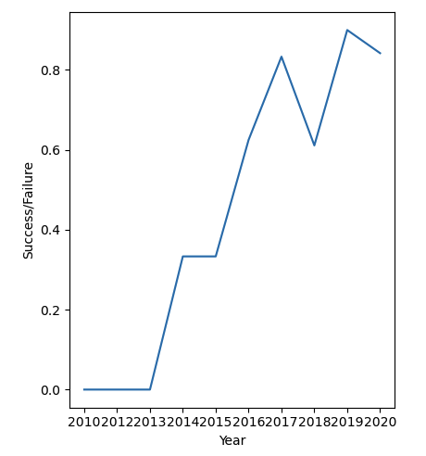
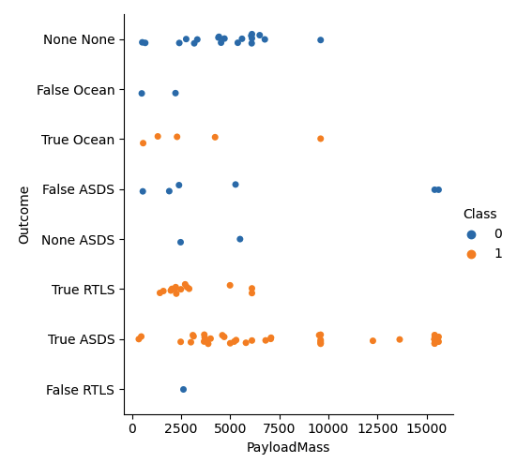
EDA with Data Visualization
We utilized a scatter plot to overlay the outcome of the launch, the relationship between Payload and Orbit type and Flight Number with Orbit type.
We utilized a line chart to observe the success rate and find any trends.
The link to the Data Collection Lab can be found here: Git Hub Link

Slide 12
EDA with SQL
We performed SQL queries to get the required information about the data. The queries performed where to achieve the following:
Names of the unique launch sites in the space mission.
Displayed 5 records where launch sites began with the string ‘CCA’.
Displayed the total payload mass carried by boosters launched by NASA (CRS).
Displayed average payload mass carried by booster version F9 v1.1.
Listed the date when the first successful landing outcome in ground pad was achieved.
Listed the names of the boosters which have success in drone ship and have payload mass greater than 4000 but less than 6000.
Listed the total number of successful and failure mission outcomes.
Listed the failed landing outcomes in drone ship, their booster versions, and launch site names for in year 2015.
Ranked the count of landing outcomes (such as Failure (drone ship) or Success (ground pad)) between the date 2010-06-04 and 2017-03-20, in descending order
Used a subquery to list the names of the booster versions which have carried the maximum payload mass.
The link to the Data Collection Lab can be found here: Git Hub Link

Slide 13
Build an Interactive Map with Folium
All launch sites were marked on a folium map utilizing markers, lines and circles.
The feature launch outcomes was assigned with a 0 or a 1 to identify failure or success.
With color-labeled marker cluster the launch sites that had high success rate were identified.
We were able to answer the question if the launch sites are near railways, highways, and coastlines, and if the launch sites have certain distance from the cities.
Explain why you added those objects
The link to the Data Collection Lab can be found here: Git Hub Link

Slide 14
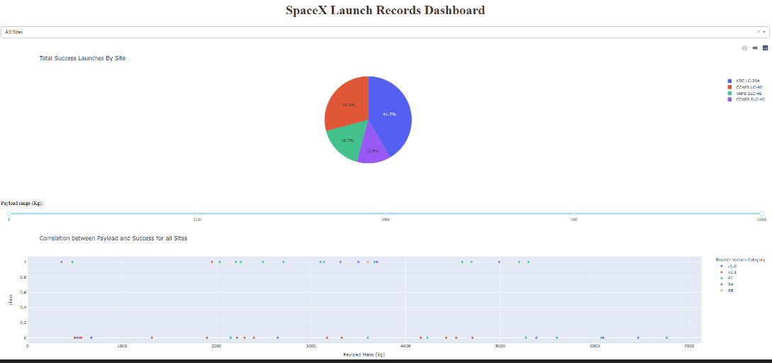
Build a Dashboard with Plotly Dash
We created an interactive dashboard utilizing Plotly dash, that contained graphs, dropdowns and data.
The interactions and plots were created to show the relationship with the payload mass in Kg and the outcome. As well, we investigated the total launches that occurred at a specific site.
The link to the Data Collection Lab can be found here: Git Hub Link

Slide 15
Predictive Analysis (Classification)
Create a NumPy array and pandas to load and transform the data
We found the accuracy of the knn_cv and plotted confusion matrix to determine the best method.
Created the machine learning using GridSearachCV
Used accuracy as the metric and improved the model by using algorithm tuning and feature engineering
Calculate the # of occurrence per orbit: df['Orbit'].value_counts()
We performed Machine Learning to determine if the first land was going to be successful to determine the cost of a launch.
The link to the Data Collection Lab can be found here: Git Hub Link

Slide 16
Results
Exploratory data analysis results
Interactive analytics demo in screenshots
Predictive analysis results

Slide 17

Section 2

Slide 18

Flight Number vs. Launch Site
We were able to find that the larger the flight amount at the launch site, the greater the success rate.

Slide 19

Payload vs. Launch Site
The scatter plot shows that the greater the payload mass for the launch site the higher success rate.

Slide 20

Success Rate vs. Orbit Type
With the bar chart, we can gather that ES-L1, GEO, HEO, SSO had the highest success rate.

Slide 21

Flight Number vs. Orbit Type
The scatter plot shows the relationship between the flight number and the orbit type. We can observe that the success rate is related to the LEO orbit but there is no relationship between flight number and the orbit.

Slide 22

Payload vs. Orbit Type
The scatter plot shows the relationship between payload vs. orbit type. The orbits PO, LEO, and ISS have the greatest success rate.

Slide 23
Launch Success Yearly Trend
The line chart displays a positive success rate since 2013, dropping in 2018 but increasing again up to 2020.

Slide 24

All Launch Site Names
Find the names of the unique launch sites

Slide 25
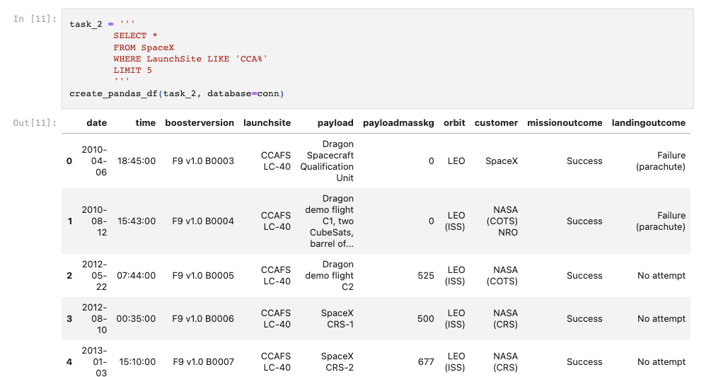
Launch Site Names Begin with 'CCA'
Find 5 records where launch sites begin with `CCA`

Slide 26

Total Payload Mass
Calculate the total payload carried by boosters from NASA

Slide 27

Average Payload Mass by F9 v1.1
Calculate the average payload mass carried by booster version F9 v1.1

Slide 28

First Successful Ground Landing Date
Find the dates of the first successful landing outcome on ground pad

Slide 29

Successful Drone Ship Landing with Payload between 4000 and 6000
List the names of boosters which have successfully landed on drone ship and had payload mass greater than 4000 but less than 6000

Slide 30

Total Number of Successful and Failure Mission Outcomes
Calculate the total number of successful and failure mission outcomes

Slide 31

Boosters Carried Maximum Payload
List the names of the booster which have carried the maximum payload mass

Slide 32

2015 Launch Records
List the failed landing_outcomes in drone ship, their booster versions, and launch site names for in year 2015

Slide 33

Rank Landing Outcomes Between 2010-06-04 and 2017-03-20
Rank the count of landing outcomes (such as Failure (drone ship) or Success (ground pad)) between the date 2010-06-04 and 2017-03-20, in descending order

Slide 34

Section 3

Slide 35
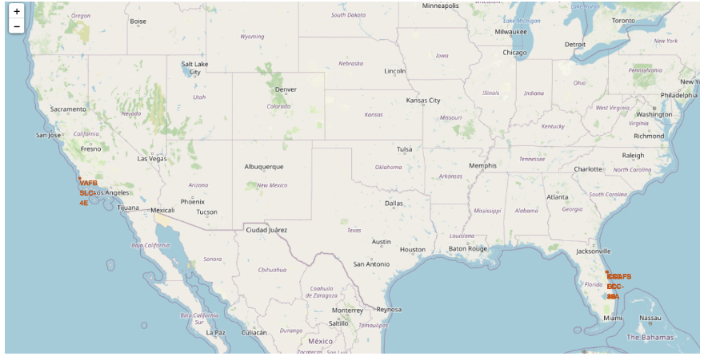
Global Map with Launch Sites
The SpaceX launch Sites are in USA coasts, specifically in Florida and California.

Slide 36

Map with Launch Sites with Markers
The green markers on the map show the successful launches and the red markers shows the failed launches.

Slide 37
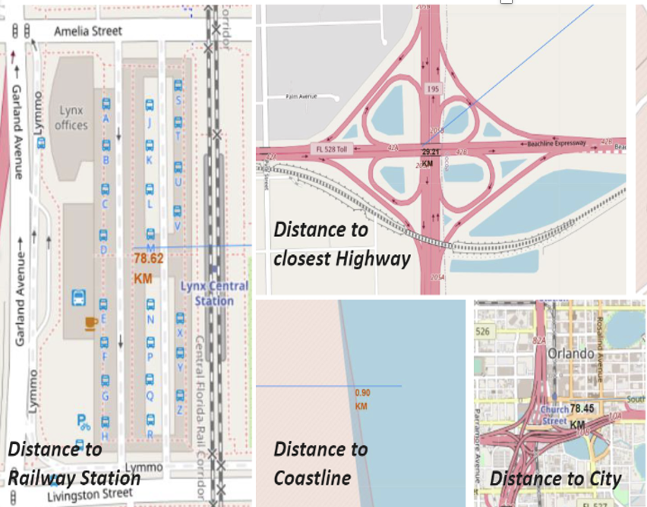
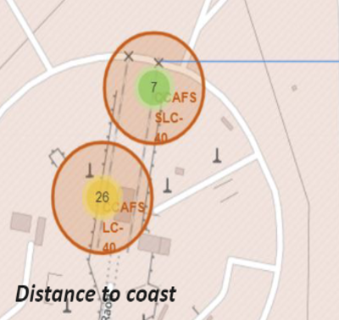
Launch Site Distance to Landmarks
We found that the launch sites are not close to railways or highways, but they are close to coastlines and away from the cities.

Slide 38

Section 4

Slide 39
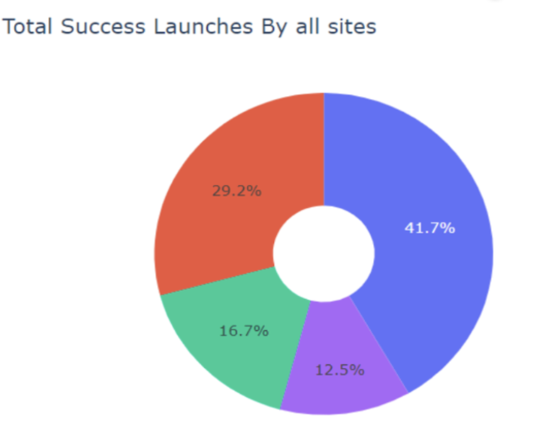
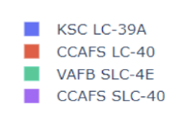
Success % by Launch Site
The most successful launch from all sites was by KSC LC-39A

Slide 40

Site with Highest Launch success Ratio
KSC LC-39A had the highest success rate of 76.9% and a failure rate of 23.1%.

Slide 41

Payload vs. Launch Outcome for all sites
The success rate for low weighted payloads is higher that the payload with heavier payloads.

Slide 42

Section 5

Slide 43
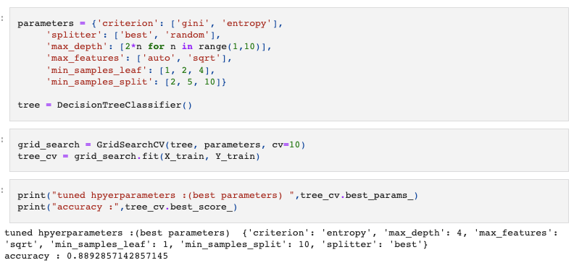
Classification Accuracy
The model with the highest classification accuracy was the decision tree.

Slide 44
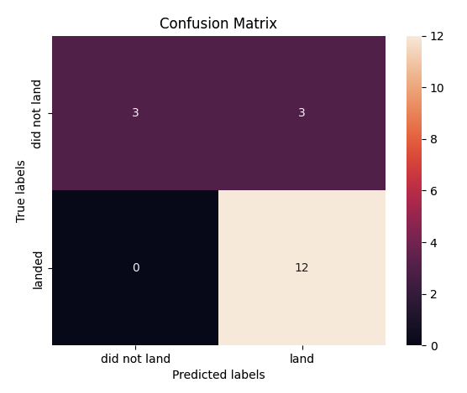
Confusion Matrix
The classifier can distinguish between different classes, and we can see that the major problem is the false positives. As an example, unsuccessful landings are marked as successful landing by the classifier.

Slide 45
Conclusions
The success rate at the launch site is greater if the launch site has a larger flight amount.
The success rates kept increasing from 2013 to 2020.
The orbits with the most success rates are ES-L1, GEO, HEO, SSO and VLEO.
The most successful launches was presented by KSC LC-39A.
The best machine learning algorithm for this project was the decision tree classifier.

Slide 46
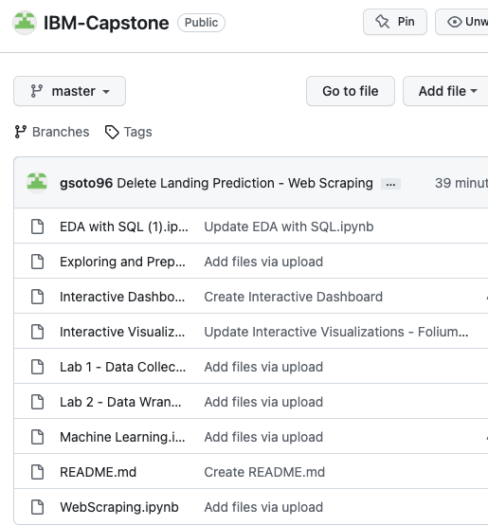
Appendix

Slide 47


